Slide 1
Exoplanet habitability Classifier
Ram, Joel, Srinand

Slide 2
Project document
https://docs.google.com/document/d/1aFxDanGqmlFzBA6_U-PU5j3XcPsI-2BoHjvsufGI_dU/edit?usp=sharing

Slide 3
Purpose
Climate change + less resources = need to find new planet for humans
This project helps makes planet-finding process faster.
Takes user input of planet data
Predicts if exoplanet is habitable (humans can live on it)
Exoplanet - planet outside solar system
Notes:
*Ram*
With modern issues such as climate change and depletion of natural resources, combined with an increase in interest in exploring space, the need to find a new home for humans has become far more important. We’ve all seen movies of people colonizing new planets in far off solar systems. Inspired by this, we created a project that takes a user's input of data discovered about a planet and determines whether it is habitable or not. This project could help save the human race as scientists and astrophysicists can quickly determine if a planet is potentially habitable to find a new home for humans quicker. In addition, there aren’t many publicly available resources online liek this, so our project could help up and coming space enthusiasts develop their interest in this subject.

Slide 4
How it works (Classifier)
Decision Tree - Computer architecture where the computer decides where to go based on previous input and intended output.
FCNN - Neural network with fully connected layers where each node can reach any type of node in the next layer.
Notes:
*Srinand*
We use decision trees to find the columns which best represent the data the most. We then feed them as inputs in a neural network using multiple fully connected layers to classify whether they are habitable (suitable for life) or not. Then we generate an image of the planet based on the user’s input data.

Slide 5
How it works (Image generator)
GAN - Type of CNN where two CNNs compete with each other, and the Generator network over time will improve its image quality based on the discriminator output.
CNN - A type of NN where it uses kernels (a matrix) to do operations on images.
GUI - An interface to visualize the output to any audience. We use Tkinter.
Notes:
*Srinand*

Slide 6
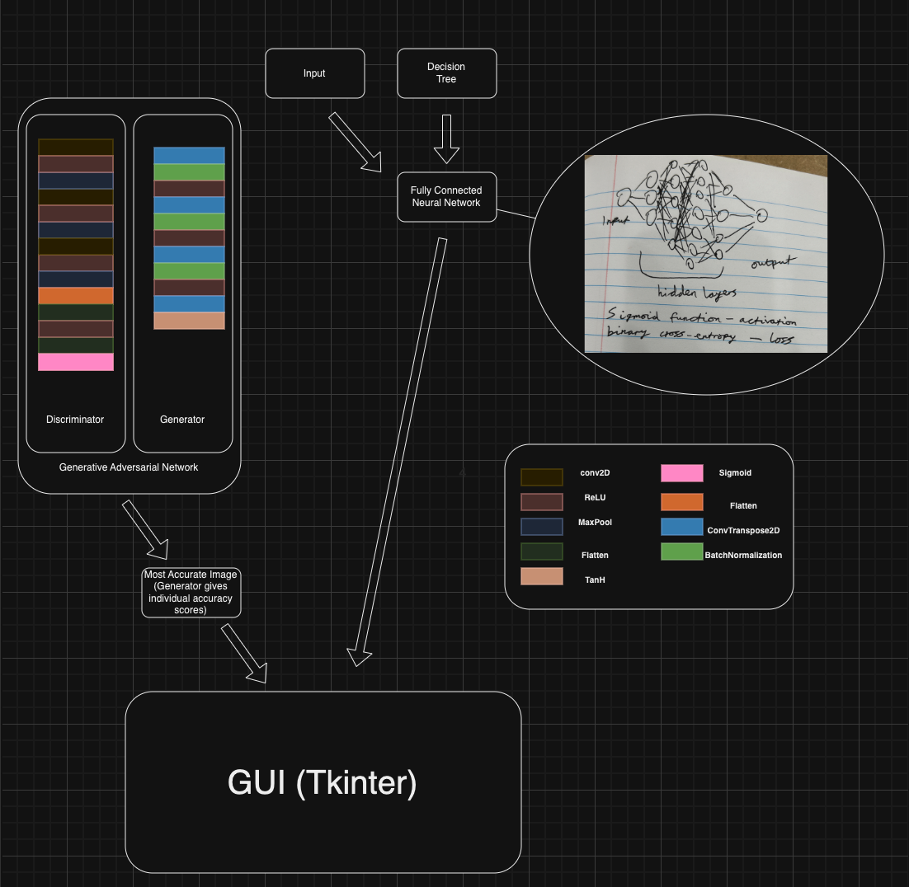

Model
Notes:
Ram
Here’s a diagram to show the entire code. A few more specifics about the FCNN is that we used sigmoid for our activation function and binary cross-entropy for our loss since both of those are more suited for our binary output.
Joel
For the discriminator, we used convolutional, relu, flattening and max pooling layers, and for the output we used a sigmoid function as it is supposed to do binary classification.

Slide 7
results
Habitability Classifier
Takes user input of planet data (flux amount)
Flux - amount of light received from a star to planet surface
Classifies if input planet is habitable or not
Image generator
Uses the NASA exoplanet images dataset to generate a potential image of the new exoplanet
Notes:
*Joel*
We used a NASA Exoplanet catalog dataset for our habitability classifier, which had 59 columns relating to attributes of Exoplanets, such as temperature, flux, eccentricity, ect.
For our habitability classifier, we used a decision tree to find the column with the most information gain (Flux), and the user would enter a certain value of flux, which would then be passed through the Neural Network and return a value between 0 and 1 (0 for not habitable, 1 for most likely habitable). We had an accuracy of about 98 percent for this.
We used a NASA dataset of 179 artistic representations of exoplanets to train our GAN model, which had a CNN architecture, and it generates a somewhat realistic exoplanet images
Finally, we integrated the Habitability classifier and GAN into a single Gui

Slide 8
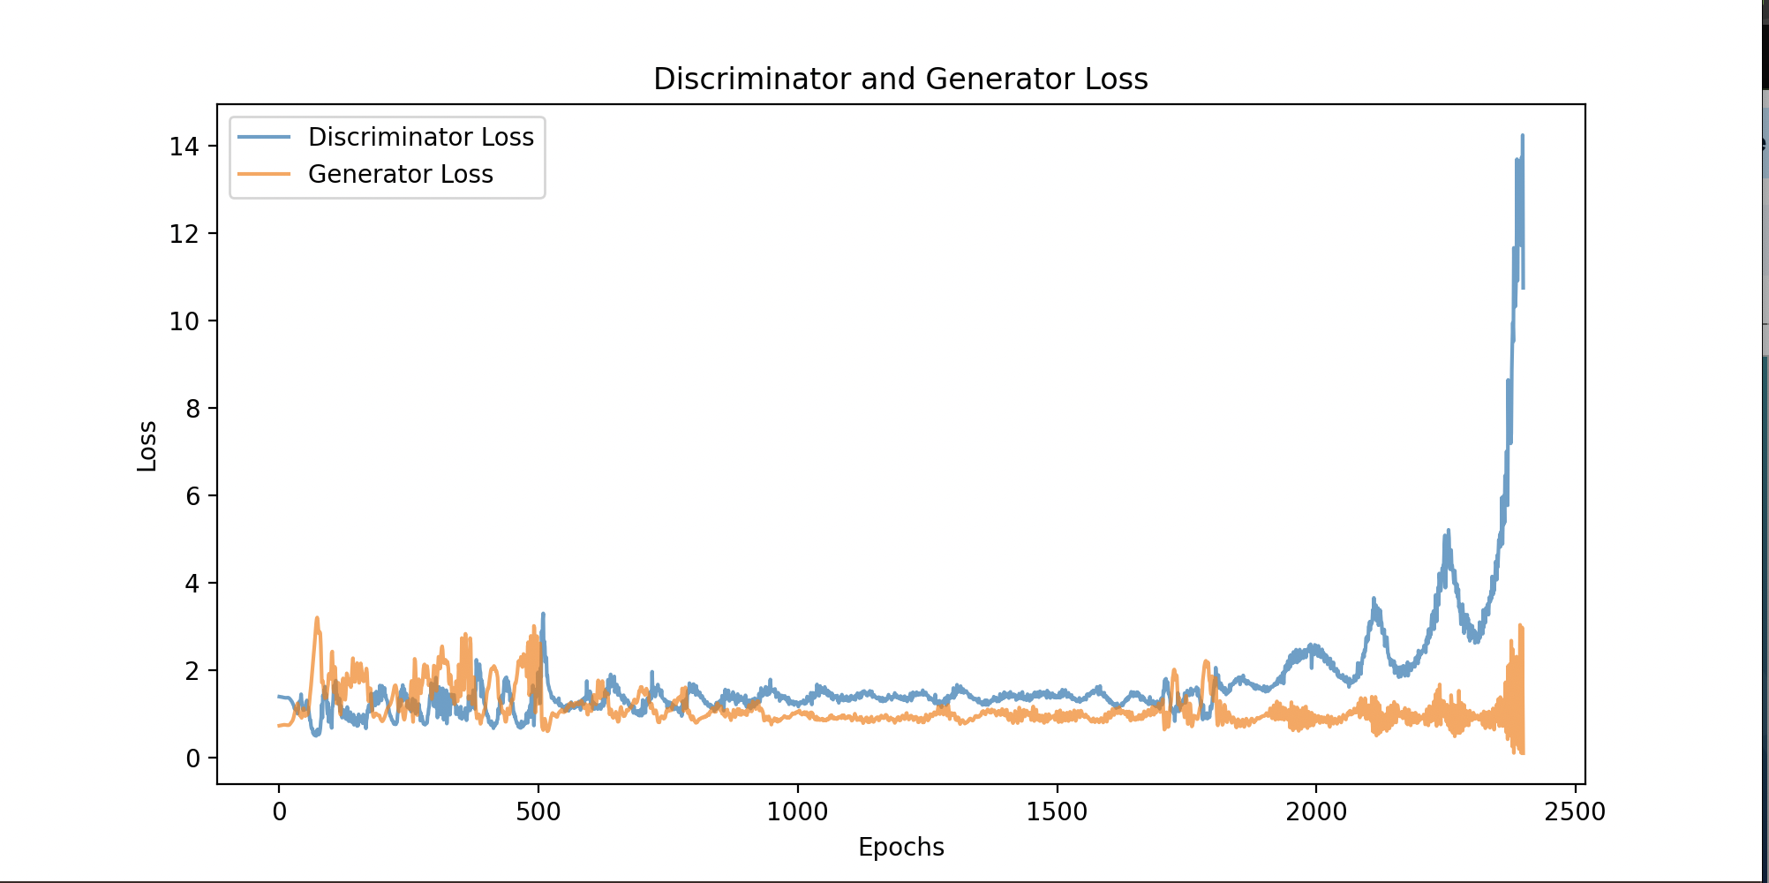
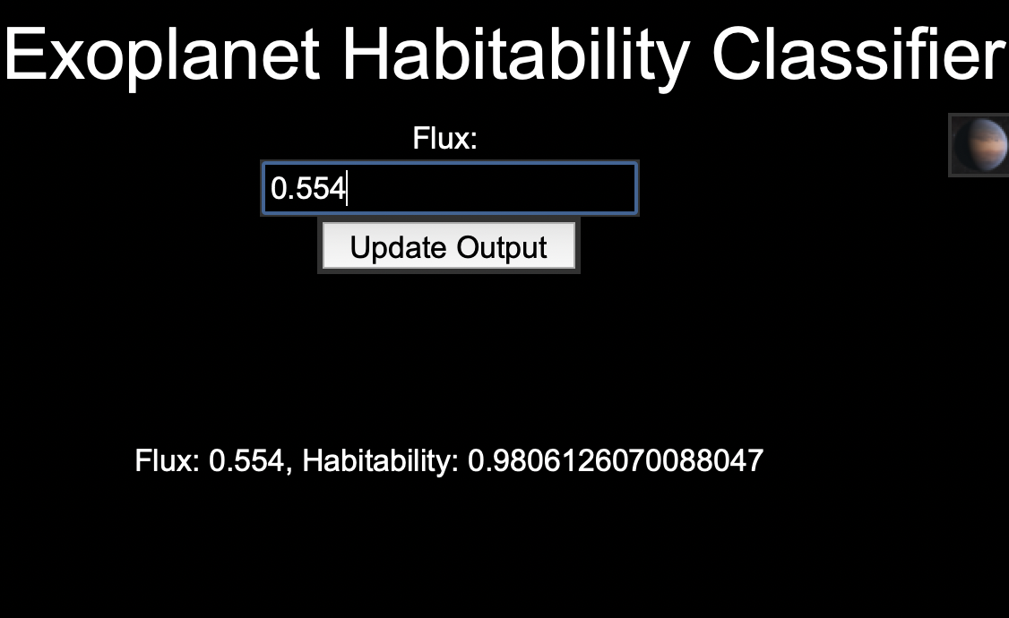
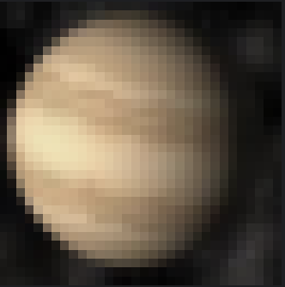
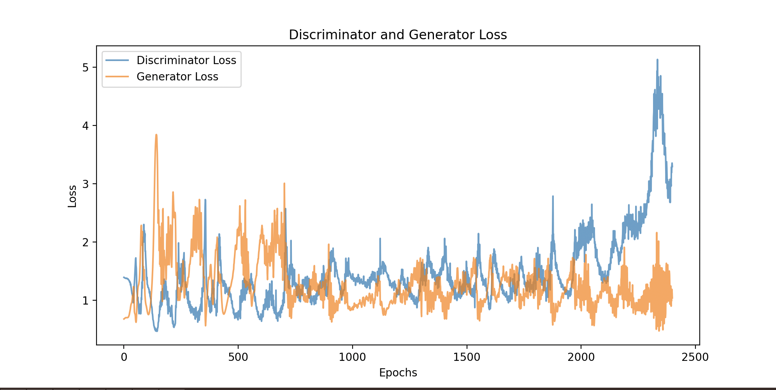
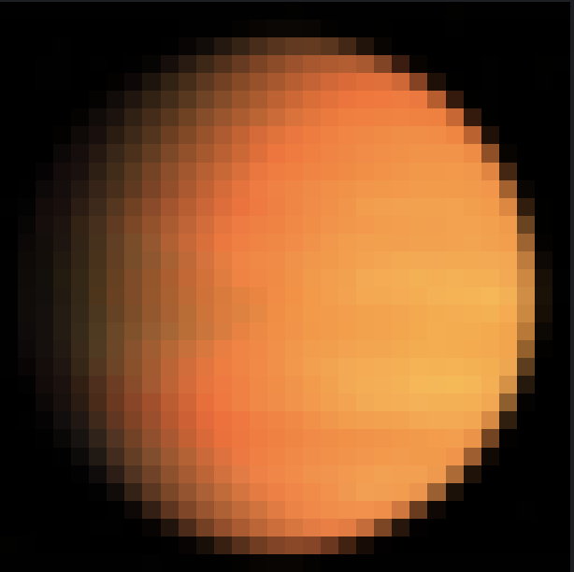
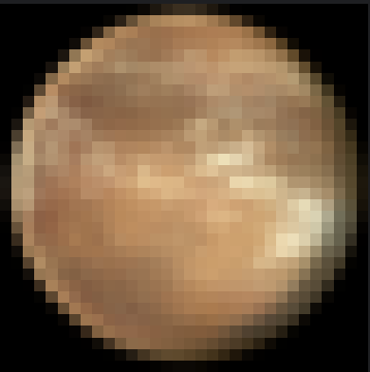
Result Images
Graphs of Generator vs Discriminator Loss
GAN-generated Exoplanet Images
Integrated GUI
Notes:
*Joel*

Slide 9
Problems + Solutions
Converted FCNNs to CNNs to increase image quality
Delayed collapsing gradient with weight initialization + feature matching loss
Added code to find best image to speed up process
Notes:
*Joel*
A major issue with our project was that the images it was outputting were extremely low quality, essentially just pixelated blobs
In order to increase image quality of the output, we switched the architecture of the Generator and Discriminator from FNNs to CNNs which were better adapted for image processing
However, there was still a collapsing gradient problem, which we delayed significantly by using weight initialization and Feature Matching Loss. (Before it collapsed at epoch 150, now it will at epoch 500)
In addition, we also added code to the image generator to find the best image out of the ones generated, and this really helped with making the integration of all the code as we no longer needed to manually find the best image.

Slide 10
What to Improve
Connect the GAN to the Decision Trees to give more relevant images
Use multiple good columns from the DT to get more varied data to go into the NN.
Make GUI interface more visually attractive
Notes:
*Ram*
We want to work on this project further after we leave this camp, so we have quite a few things that we want to add to the project.
Firstly, developing the GAN and outputting images that aren't a blurry mess was a lot more difficult than we expected, and we decided to cut out the integration with the decision tree due to time constraints. Integrating this would provide images that are more relevant to the user’s input.
Next, we also want to take in more user inputs to generate a more accurate classification (so basically use more columns than just flux)
Finally, we also want to make the GUI interface more visually attractive so that normal people (not scientists and astrophyscists) would be more interested in playing around with it. *rant about nothing publicly like this*

Slide 11
Acknowledgements
Thank you Omeed, Sanjana, and Hamsini for giving us the knowledge to do this project.
Thank you Dr. Anurag Nagar and Dr. Jay Veeraswamy for making this camp possible.
Notes:
*Srinand*

